Slide 1

Storetail DataWarehouse Project Clickhouse Meetup
Oct 2018

Slide 2
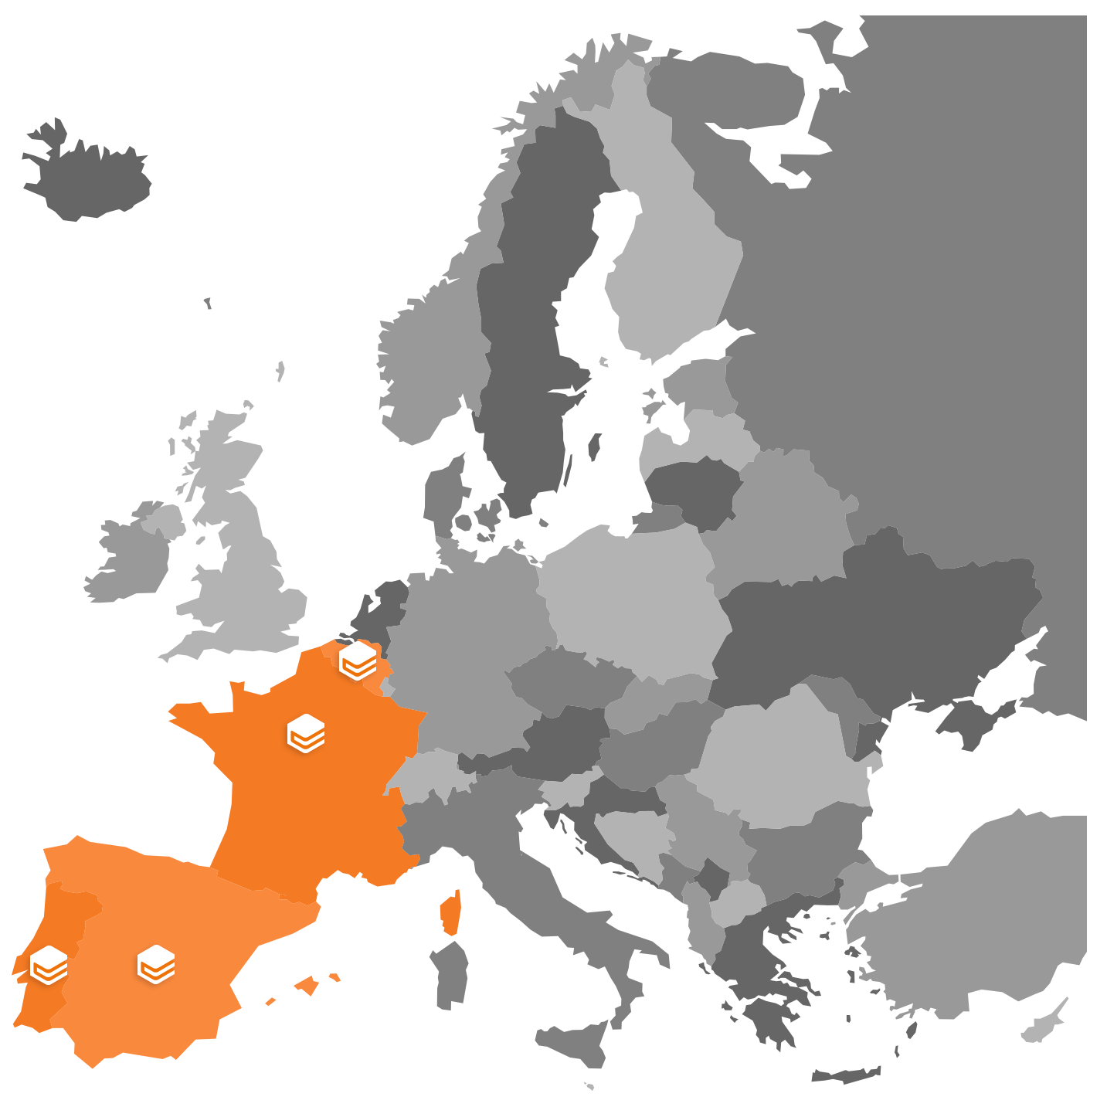




















STORETAIL: RETAIL MEDIA AT SCALE
Founded in 2014
65 employees
93% French E-Grocery players & major Brands
Recently acquired by Criteo
Etc…

Slide 3
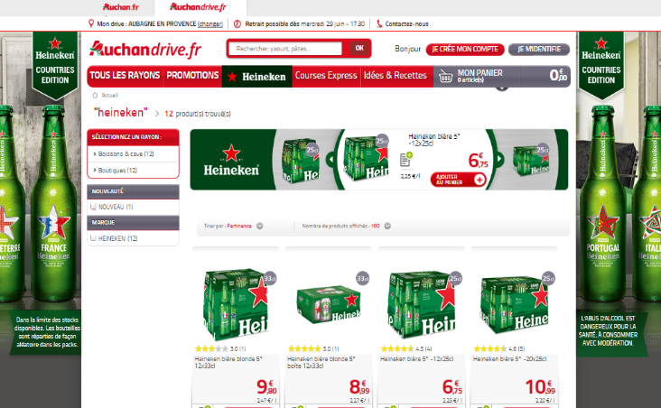
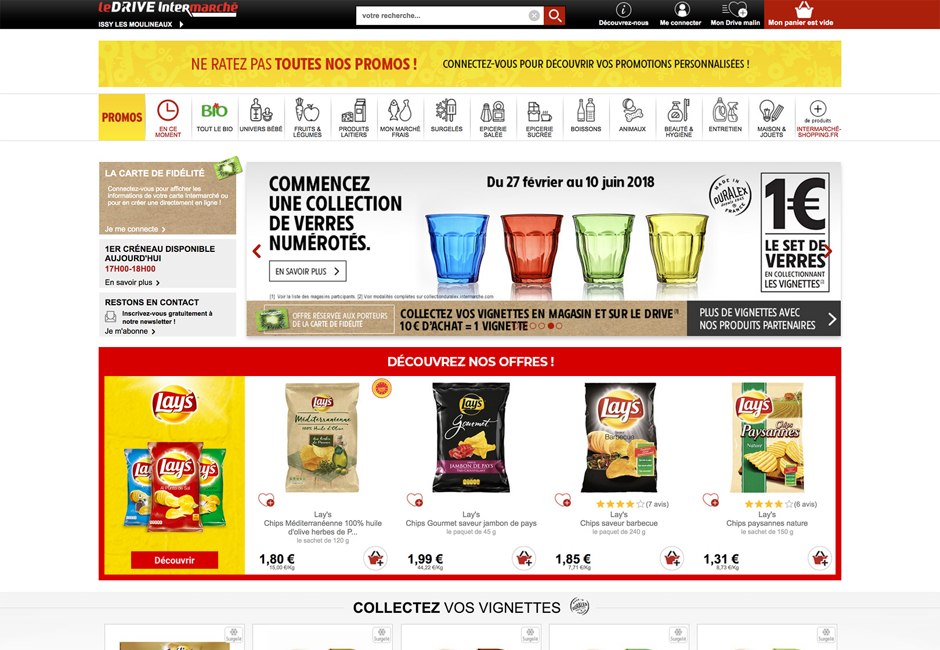
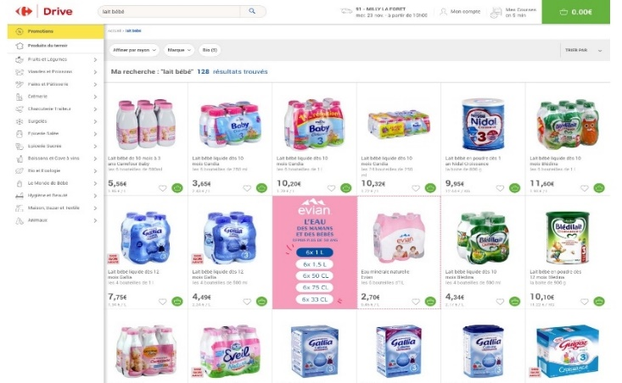

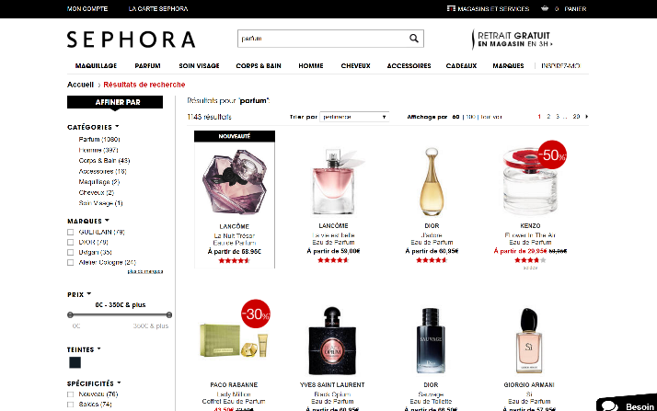
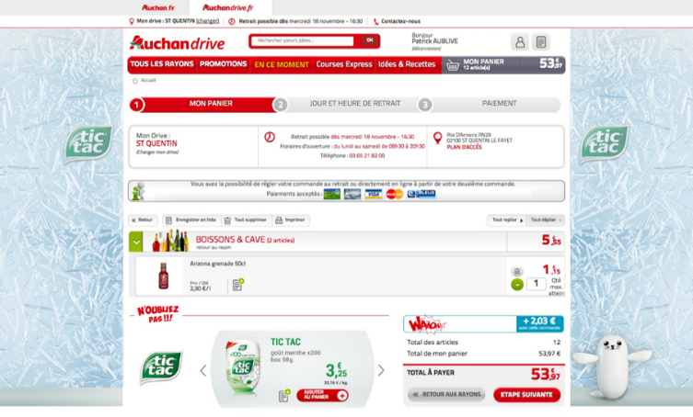
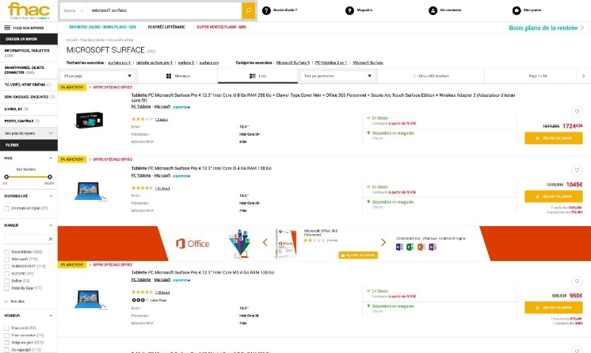

STORETAIL: e-commerce ads GALLERY
Innovation is key
Every quarter, we release new online merchandising solutions, mostly after discussion with our Retailer partners
Searchandising
Showcase
Double product tile
Make sure to place your products as 1st result on Search Result pages
Benefit from home pages high impact to showcase your range of products
Increase your sales by giving extra-visibility to your products with this native tile: up to 5 products in 1
Flexible
a centralized campaign management system: Manage all your existing formats - including IAB
E-Retail Native Ad
Checkout
Digital Shelf Barker
Stand out from classic display banner ads by activating integrated visibility directly into editorial content
Interact just before the payment. Suggest to shopper, products not seen during his shopping trip or according to his basket
Boost your products’ visibility and recreate cross-sell purchase within list pages

Slide 4




Storetail: suite for retailers
PREMIUM
PRIVATE MARKETPLACE
AUDIENCE EXTENSION
SELF PROMOTION
Compatible with all major CMS on the market + other DSP/SSP & DMP Platforms
100% proprietary technology

Slide 5



STORETAIL: In Numbers
~40 millions events/day
+10 Billions events to date
x2 Growth
year over year

Slide 6
STORETAIL: Why a new Data-Warehouse?
Replacing our tracking log storage
ELK
# Elasticsearch node
Performance
Memsql
No nested data type => denormalization
Licence for HA
Expected new usage in the product
Log-Collector
Elasticsearch
batch/day
MemSQL

Slide 7
STORETAIL: Poc – Jan 2018
Druid
Only keep aggregation
Ops complexity
Hadoop (HDP)
5-10TB isn't really big-data
Forget sub-second query
Citus
Less performance
Couchbase
Data isolation impossible
Key/Value oriented
ClickHouse

Slide 8
STORETAIL: Architecture
Streaming architecture
Kafka => ClickHouse
Develop a scala inserter from Kafka to ClickHouse
ClickHouse cluster
6 nodes, 3 shard, replication factor of 2 => 3 soon
Separate database by retailer
One table in MergeTree
Backend
Migrate query
Superset
Log-Collector
Kafka
Clickhouse Cluster

Slide 9
STORETAIL: Challenges
Documentation
It's improving but still hit some caveats
Cluster architecture understanding.
Small community
Missing Features & issue
Handle failures while importing historic from ELS
Deletion wasn't there... so dropping full partition :(
Encounter few funny issue => #2156

Slide 10
STORETAIL: Wins
Now fully in production
ingesting - April 2018
Backend - Aug 2018
Improved speed of reporting
Handling better segmentation
One source of data => less discrepency
Lots of possibility in the future
Using other engine of mergeTree table for specific usage

Slide 11
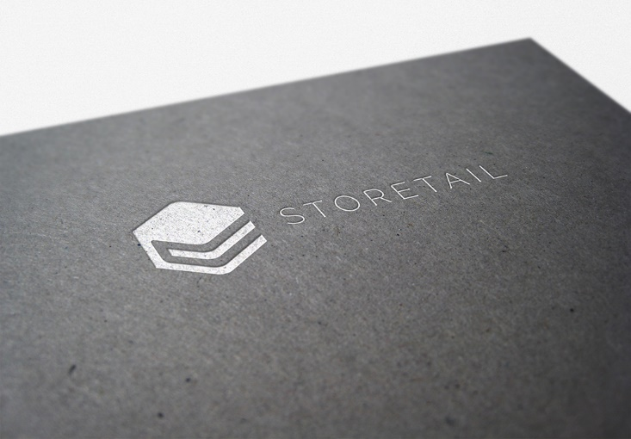
Q&A

